Slide 1
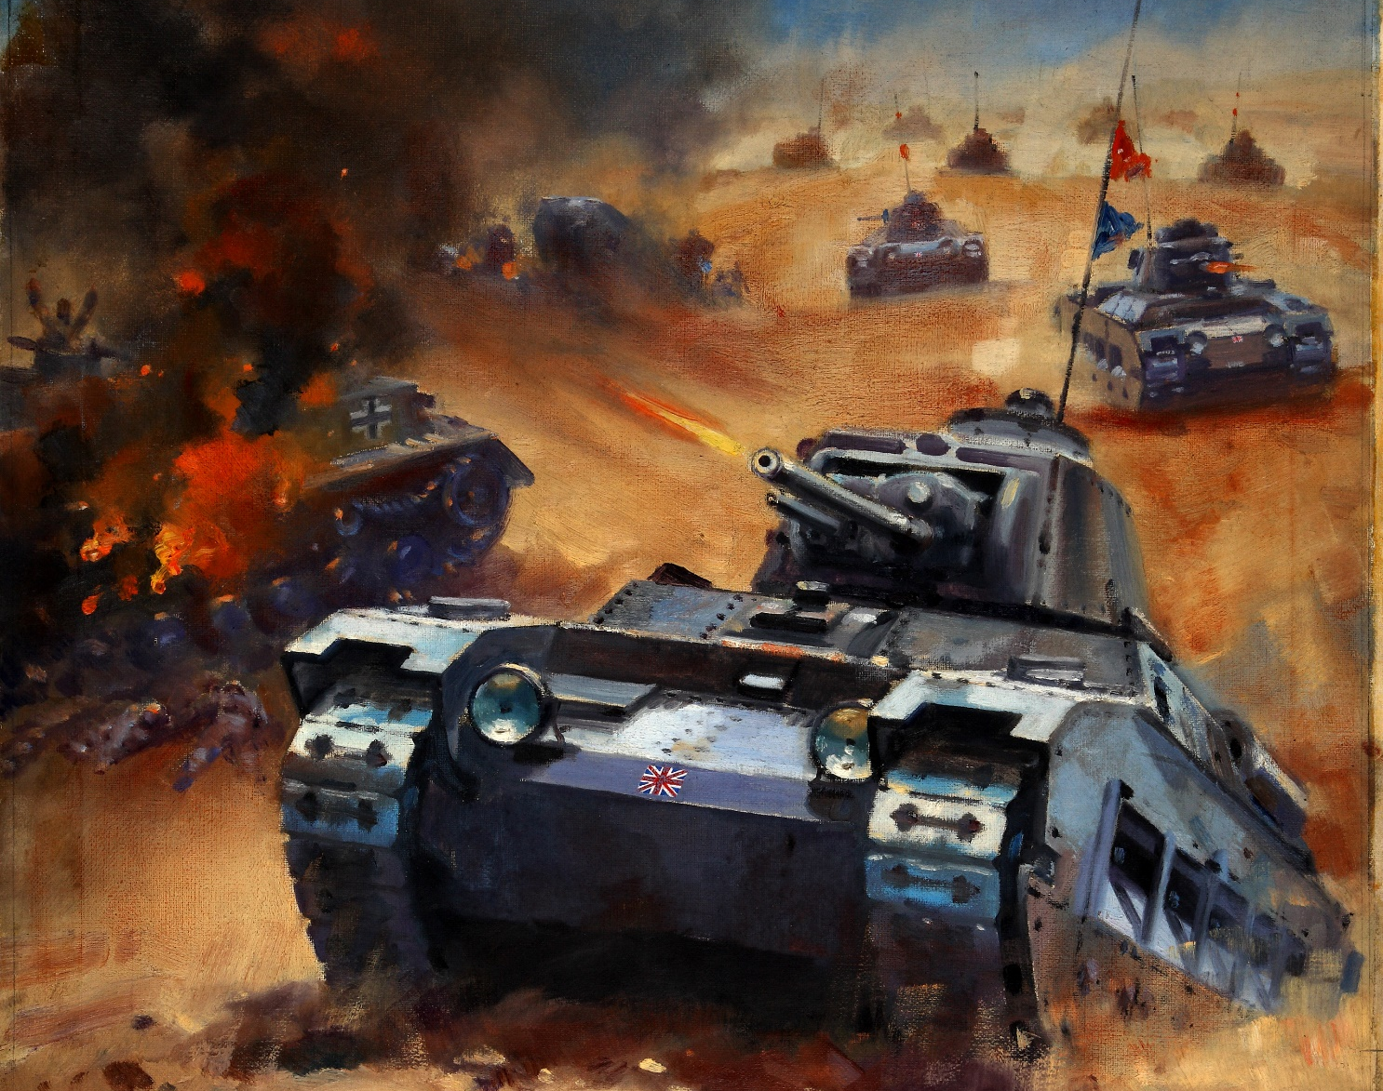
Guardian of the Outlands

Slide 2
Summary
2D top-down shoot ‘em up
PC (web)
Concept
Defend your stockpile of barrels
Player vs Entropy
Smart AI enemies try to:
get to a barrel
pick it up
escape with it
chase the player

Slide 3
Gameplay
Earn points for
shooting enemies
each barrel left at the end of a wave
Lose points for
crashing into an enemy
Power-ups
invincibility
increased damage
Hazards
oil slicks
tar pits
Different types of enemies
slow and tough
fast and weak

Slide 4
Extras
Leaderboards
score
number of waves survived
time

